Slide 1

SGGS App Database and API Development
Through Android Application Integration

Slide 2

Introduction
This project aims to develop a database and API for an Android application.
The database includes data on students and their academic records.
The project focuses on enhancing database management and facilitating efficient access to attendance records, exam results, real-time event notifications, etc.

Slide 3
Project Objectives
Design and implement a RESTful API to handle data transactions between the college's database and the Android application.
Connect the API securely with the college's database to retrieve and update information seamlessly.
Enable functionalities for attendance management, exam result retrieval, and event notifications within the Android application.
Implement authentication and authorization protocols to ensure data security and privacy.
Develop the API with scalability in mind to accommodate potential future enhancements and ensure optimal performance.
API Development
Database Integration
Functionality Implementation
Security Measures
Scalability and Performance

Slide 4
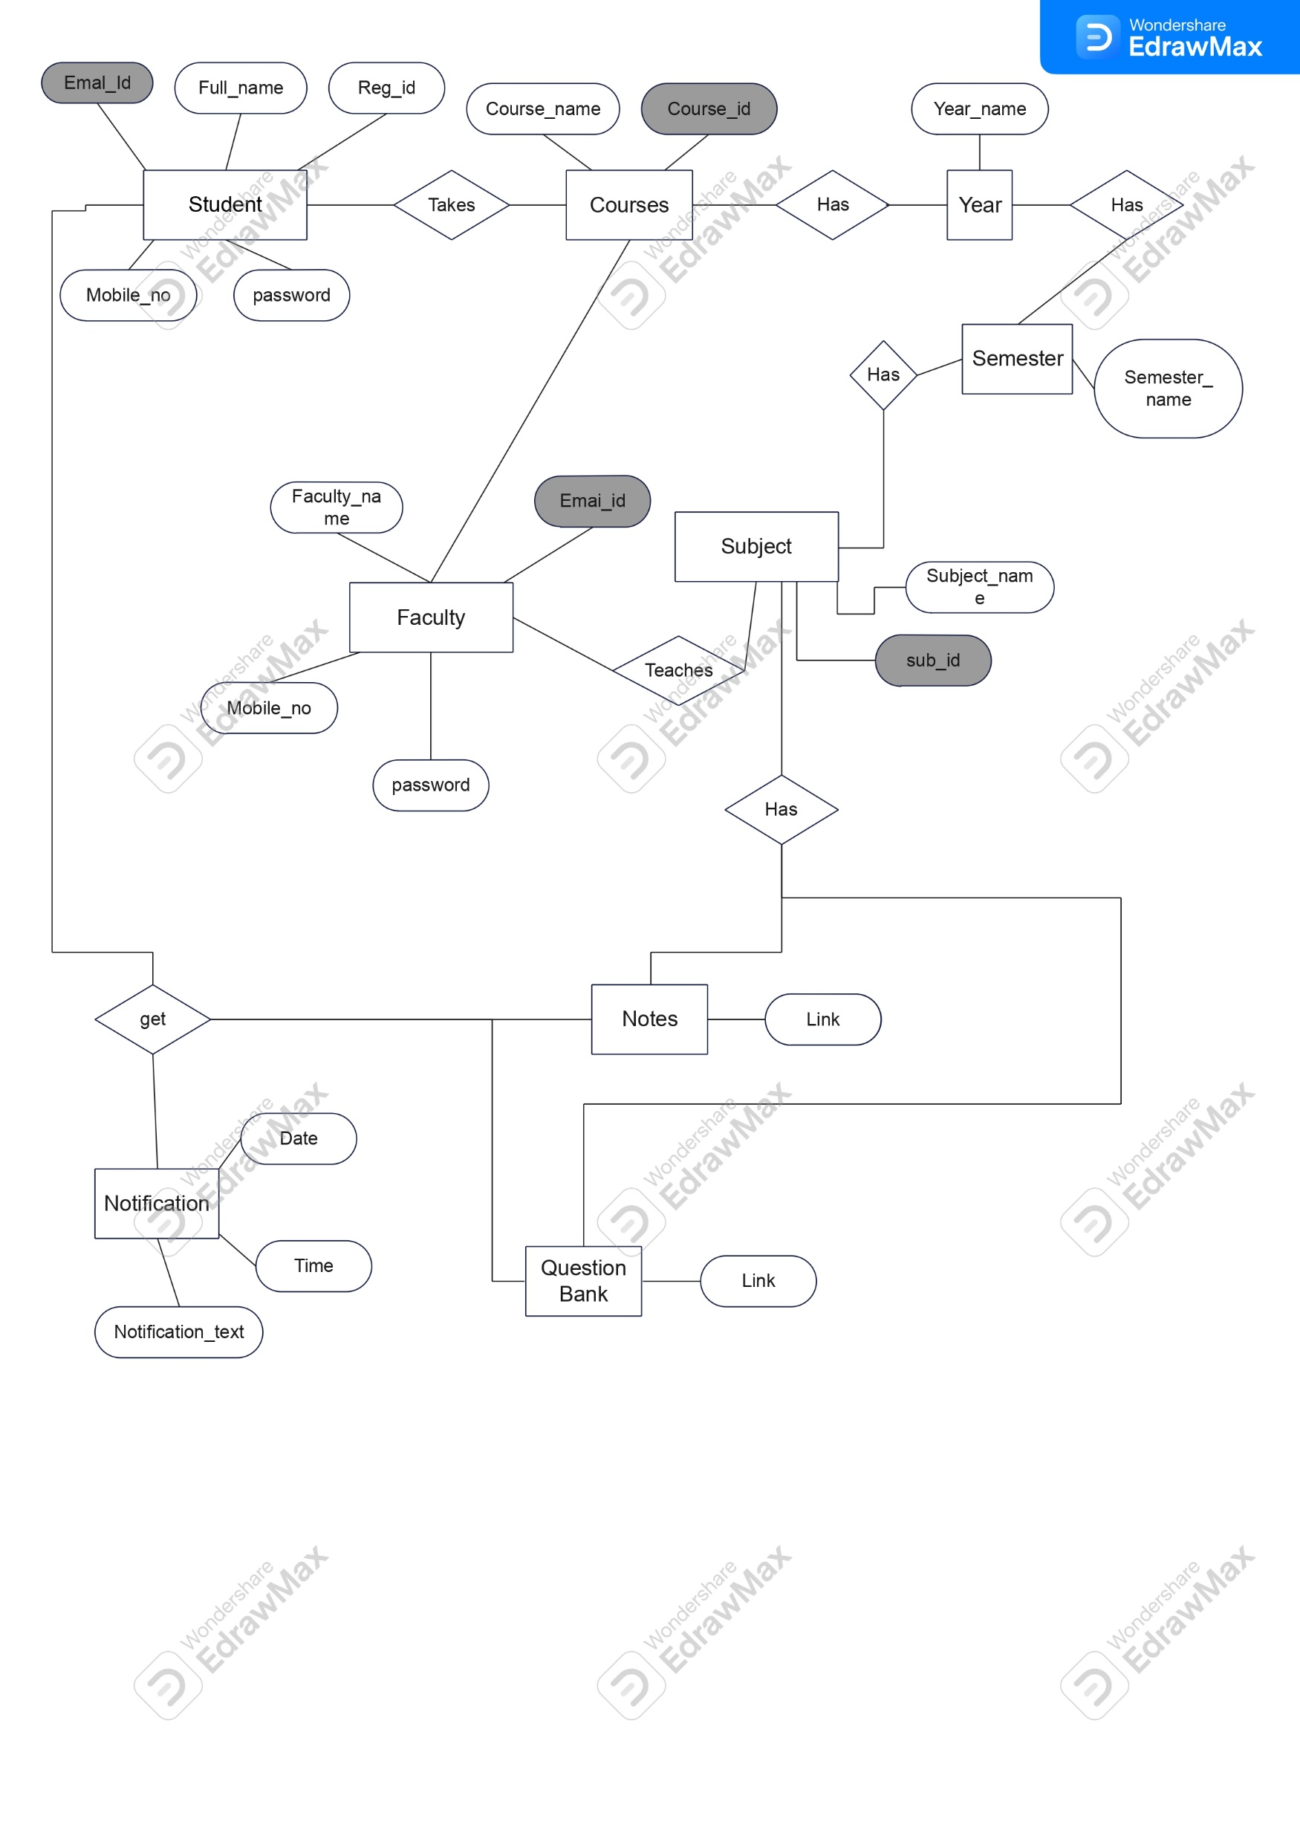
ER Diagram

Slide 5

Methodology
Phase 1: Planning and Design
Requirement Analysis: Gather specific requirements from the college administration, faculty, and students regarding desired functionalities.
API Design: Define API endpoints, data structures, and interactions between the Android app and the college's database.
Phase 2: Development
Backend Development: Build the API using suitable frameworks and programming languages for robustness and efficiency.
Database Integration: Establish secure connections and mechanisms for data retrieval and storage.
Authentication Setup: Implement secure authentication methods (e.g., JWT, OAuth) for authorized access.
Phase 3: Testing and Implementation
Unit Testing: Conduct rigorous testing of individual API endpoints to ensure functionality and reliability.
Integration Testing: Verify seamless integration between the Android application and the API.
Deployment: Deploy the API to a suitable server environment for production use.
Phase 4: Documentation and Maintenance
Documentation: Prepare comprehensive documentation for API usage, endpoints, and integration guidelines.
Maintenance Plan: Devise a maintenance strategy to address potential bugs, updates, and future enhancements.

Slide 6
Future Enhancements
Implementation of additional features like course enrollment, timetable management, etc.
Integration with other platforms (web, iOS) to widen accessibility.
Continuous improvement of security measures to adapt to evolving threats.
Mobile Notification Integration: Enable push notifications within the API to notify students about important updates, deadlines, or changes in schedules, enhancing communication efficiency.

Slide 7

Conclusion
Improved communication and accessibility
User-centric interface and documentation
More connected campus community

Slide 8
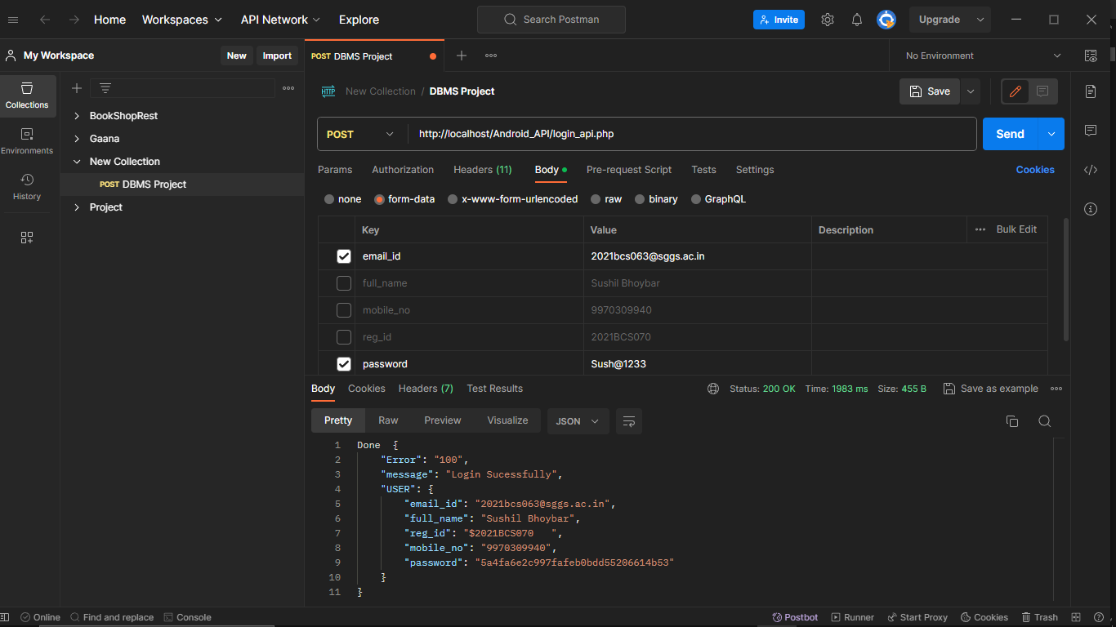

Slide 9
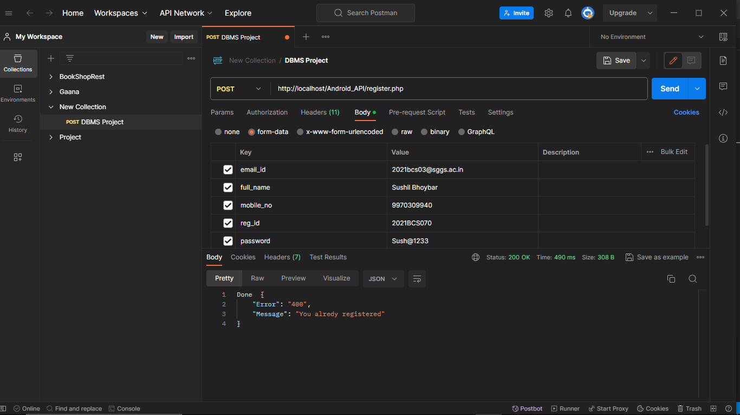

Slide 10
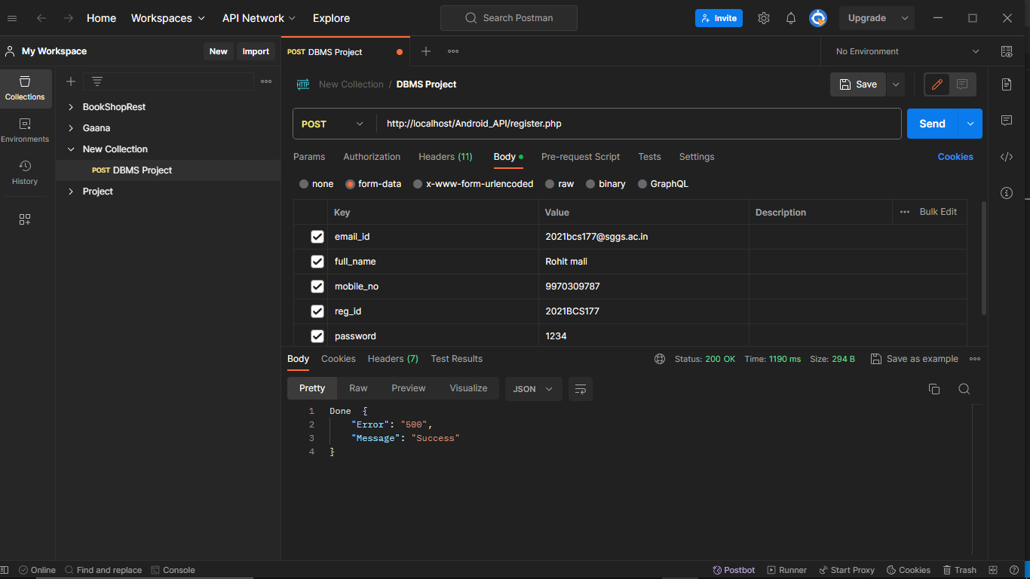

Slide 11
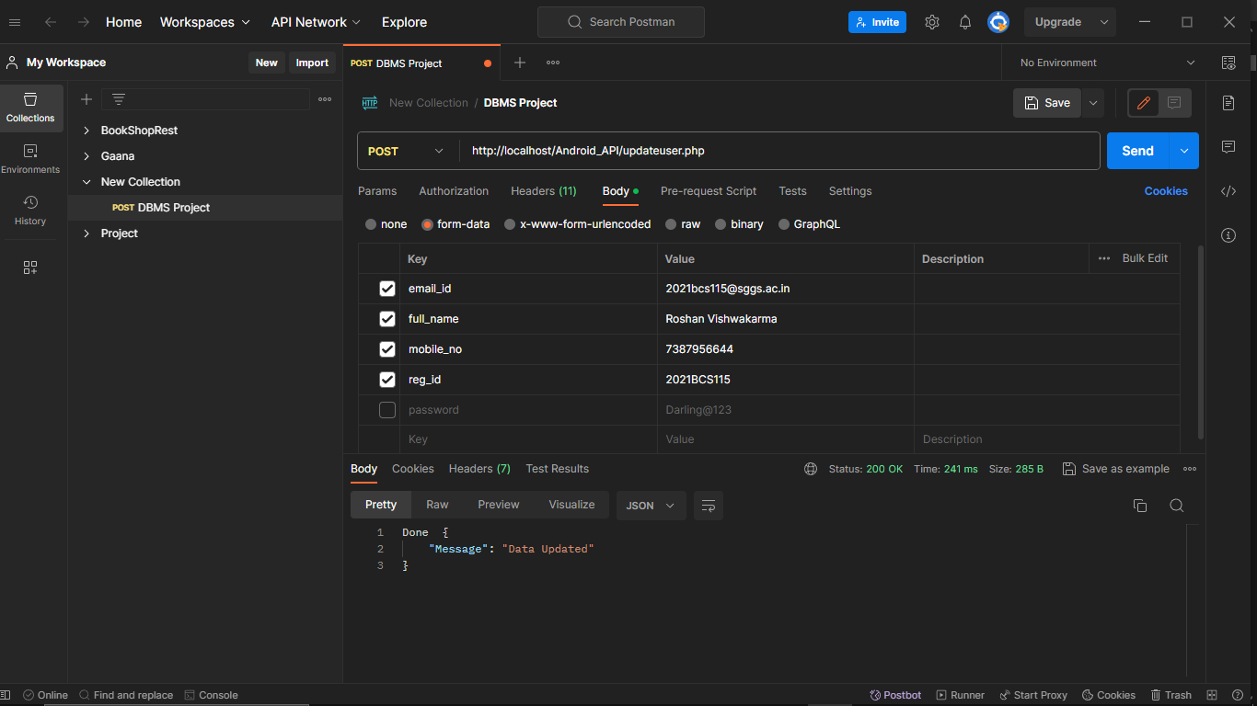

Slide 12
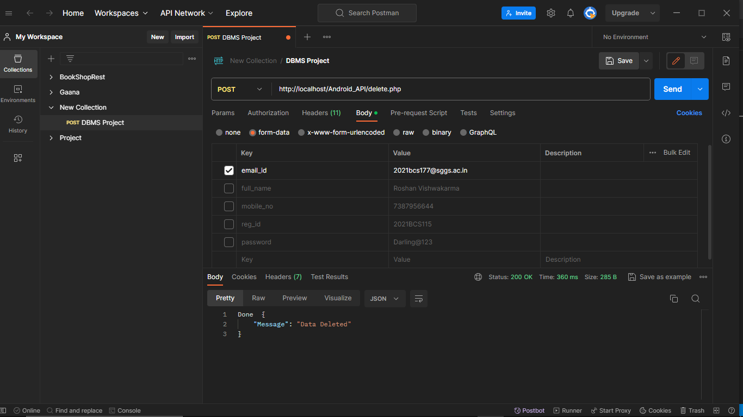

Slide 13
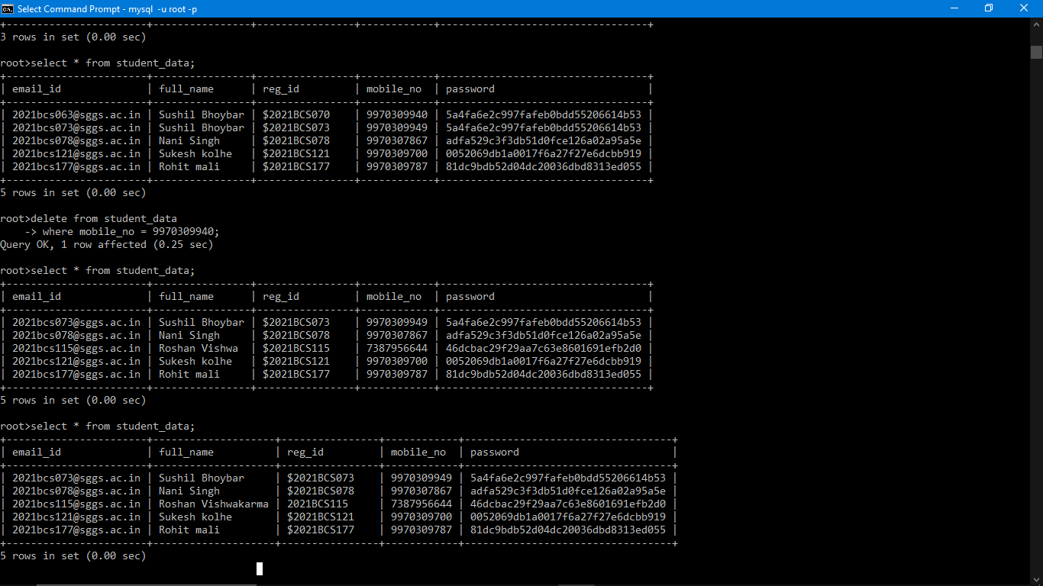

Slide 14

Thank You!

